Slide 1
Faculty Workload, Dashboards and more Dashboards…Oh My!
Nancy Hardy, Academic Planning Database Coordinator
Office of Institutional Research, Effectiveness and Planning
California State University, Sacramento

Slide 2
Introduction
Sacramento State has developed specialized annual faculty reports including the Faculty Teaching Assignment Report (FTAR), a historical dashboard containing over 5 years’ worth of data as well as a historical dashboard on courses taught here at Sac State.
These reports demonstrate faculty teaching load (WTU), assigned and reimbursed release time, course enrollment, Student Credit Unit (SCU), Full-time Equivalent Students (FTES) and Full-time Equivalent Instructional Faculty (FTEF) as well as course count and classification.
These reports were originated and requested by the Provost and Vice Provost in 2007. To date, they are used regularly in support of planning, budget allocation, and faculty hiring.
In the past, these reports were generated in Excel and published to the campus community. Now, we have been able to create a Faculty Teaching Assignment Report dashboard that is more dynamic and interactive with 5 years of historical data which is easier to use and navigate.

Slide 3
Why do we care?
Sacramento State utilizes these reports to help make decisions
Historically speaking, APDB holds a lot of the university's historical data on faculty and course data.
Trend analysis can now be done quickly and all in one place
Our office wants to assist various entities on campus with data and research
Faculty and Staff can now utilize the data quicker and more efficiently

Slide 4

Processes
Extract information from the CMS System for any given semester-Perform standard APDB edits and submit final APDB report to the Chancellor’s Office
Use flat faculty and section summary files received from the Chancellor’s Office to generate reports
Verify and cross reference all data inputs
Create reports and use Tableau for interactive visualization and reference

Slide 5

Steps
Very important that your department coordinators are on top of making sure that your faculty workload is correct, that your schedules are reported correctly
They need to pay special attention that your workload matches the faculty HR contract FTE by term! Add up teaching assignments, release time units and any coordinative or administrative time.
Workloads must be reconciled before census date. Fall 2023 is Sept.25th, Spring 2024 is February 16th.
Once the data is merged and free of error, the following base reports are created to which the dashboards are then formalized in Tableau.
After acquiring the Course Section and Faculty Summary files from the Chancellor’s Office, the file gets merged with the section summary file and with the data provided by the Office of Human Resources.

Slide 6
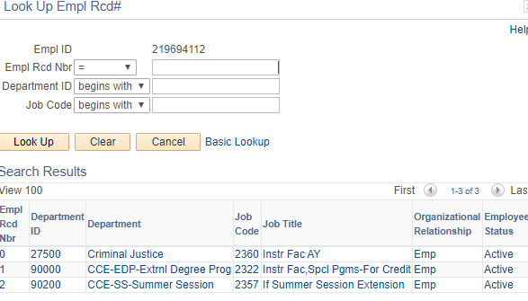
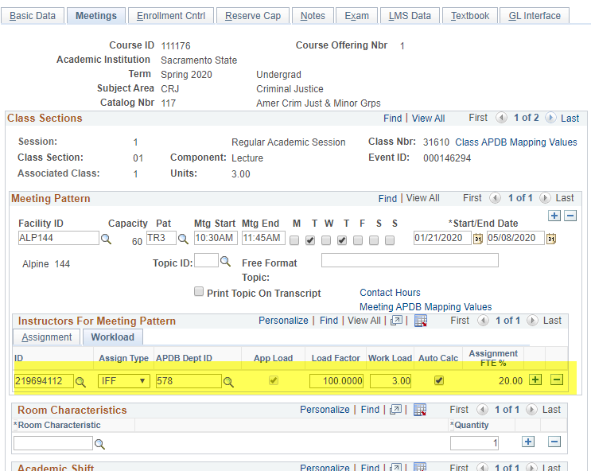
Workload, job codes and employee record numbers
- Need to check when faculty teach in more than one department or college
- Job codes must coincide with department they are teaching and the job they are doing
- All load factors must add up to 100% which means all team taught courses must be divided out correctly
- All workloads should be assigned and calculated on the 1st meeting pattern

Slide 7
New Dashboards utilizing Tableau
The new more interactive Faculty Course Assignment report details the instructor’s workload by individual course(s), student course credit, enrollment per section, team teaching percentage, Weighted Teaching Unit and FTES generated.
But now, users can drill down by each of the Colleges, Departments, and even by Faculty. The visualization allows the user to get College, Department totals based on their preferences. And most importantly….they can do this quickly.
https://www.csus.edu/president/institutional-research-effectiveness-planning/dashboards/
https://www.csus.edu/president/institutional-research-effectiveness-planning/dashboards/faculty-workload.html

Slide 8
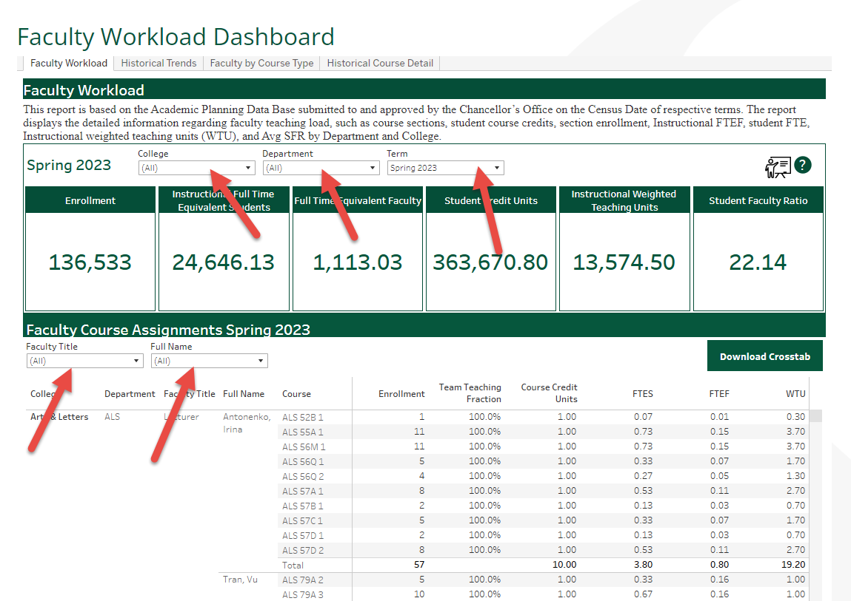
Faculty Teaching Assignment Report

Slide 9
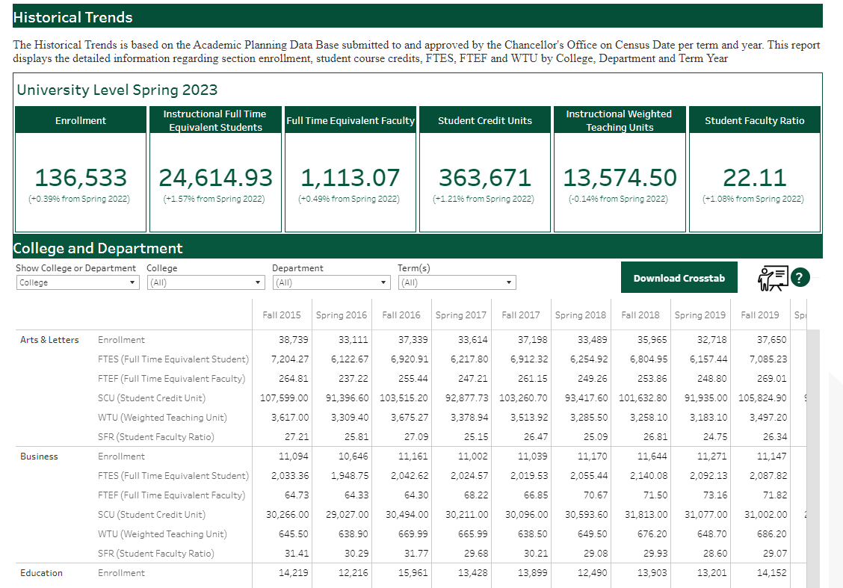
ADDITIONAL TABLEAU DASHBOARDS
The reports are also used to create trends analyses. The 5-year academic comparison report shows the difference in FTES, FTEF, SCU and WTU, as well as related trends. Again, by adding in the same information from the previous terms, we now have historical data that is easily accessible and more dynamic. The statistics are manageable and drillable based on the users needs. The user can decide to create even more meaningful tables and graphs.

Slide 10
HISTORICAL COURSE DETAIL BY COUNT, LEVEL & CLASSIFICATION
The Historical Course Detail report is a new dashboard using the Faculty Course Assignment base data to report information on the courses taught here at Sac State.
We can now see how many course sections there are historically by College and by Department. We can run a percentage difference graph to show the five-year trend.
Subsequently, the Provost, Deans, and College Chairs use these reports for budget allocation, planning and policy decision making.

Slide 11
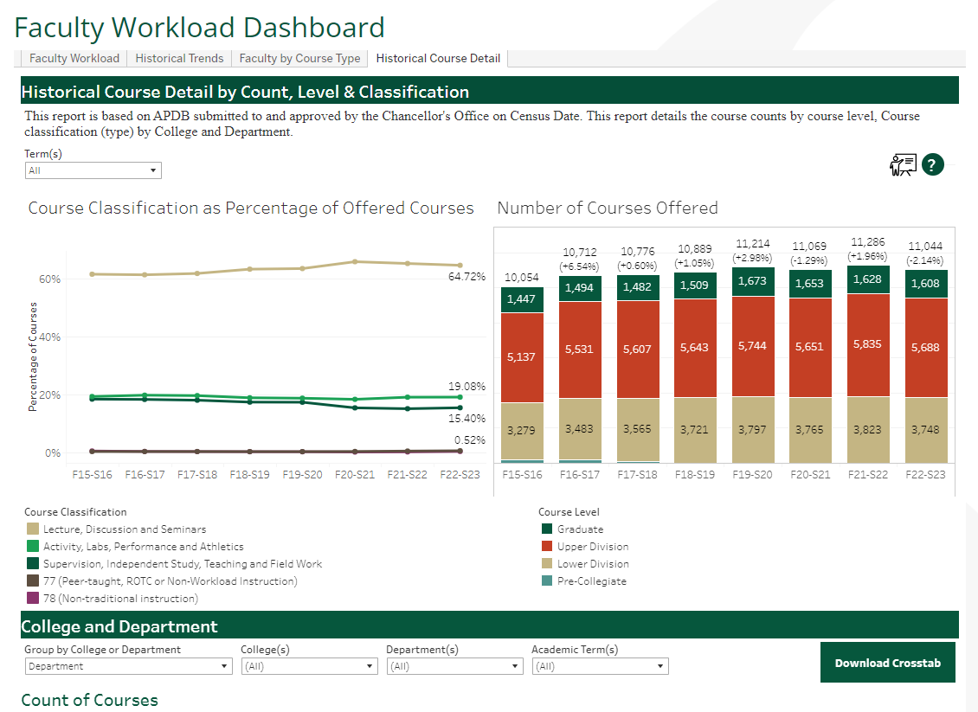

Slide 12
Historical Course Info
The Count of courses by classification gives the campus community and decision makers an answer as to the “type” of courses being taught by Department and by College. As you can see from the informational graph, we can easily detect that there are a greater number of Lecture, Discussions and Seminars taught then there are Activity and Lab courses and further, Supervision and Independent Study.
We can now also see the trajectory of adding course sections and modality trends.
Course Planning could use this report for historical use and aid in future course planning.

Slide 13
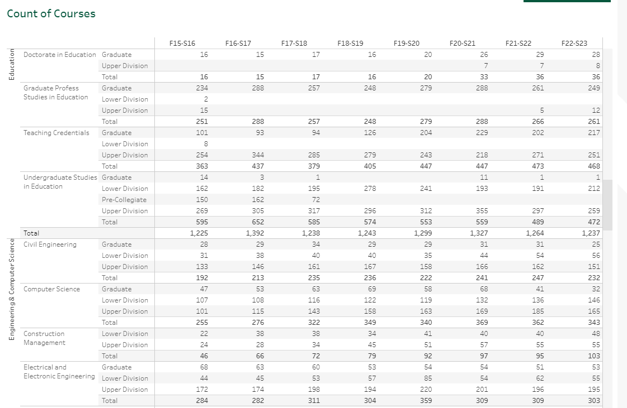

This Table shows the Course Count by Course Level. The user can find out how many courses taught at Sac State are Pre-Collegiate, Lower Div., Upper Div., and Graduate by College and Department

Slide 14
Contact
Nancy Hardy, Academic Planning Database Coordinator
California State University, Sacramento
Office of Institutional Research, Effectiveness and Planning
6000 “J” Street
Sacramento, CA 95819-6028
916-278-7914 (p)
916-278-6828 (f)
nhardy@csus.edu
www.csus.edu/oir

Slide 15


Questions?
Nancy Hardy, Academic Planning Database Coordinator
  nhardy@csus.edu

